Slide 1

A Gentle Introduction
to Causal Inference

Slide 2



The schedule for each session…
14:00 -- 14:10 Introduction and Motivations
14:10 -- 14:50 Presentation and Q&A
14:50 -- 15:00 10-minute Break
15:00 -- 15:45 Practical Session
15:45 -- 16:00 Final Wrap-Up
www.cdcs.ed.ac.uk

Slide 3

Welcome!
Chris Oldnall
www.cdcs.ed.ac.uk

Slide 4

Week 1:
Foundations of Causality
www.cdcs.ed.ac.uk

Slide 5
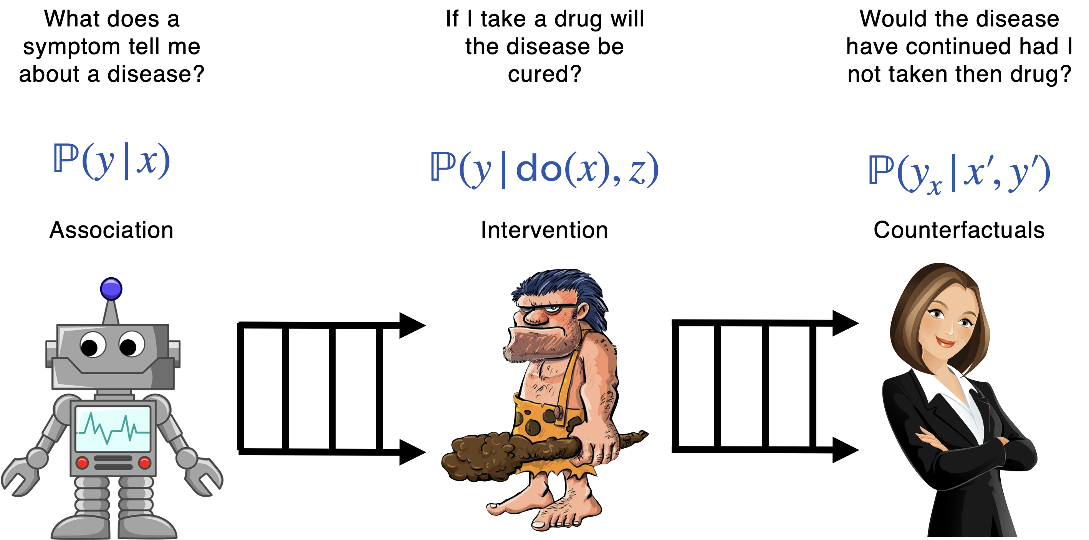
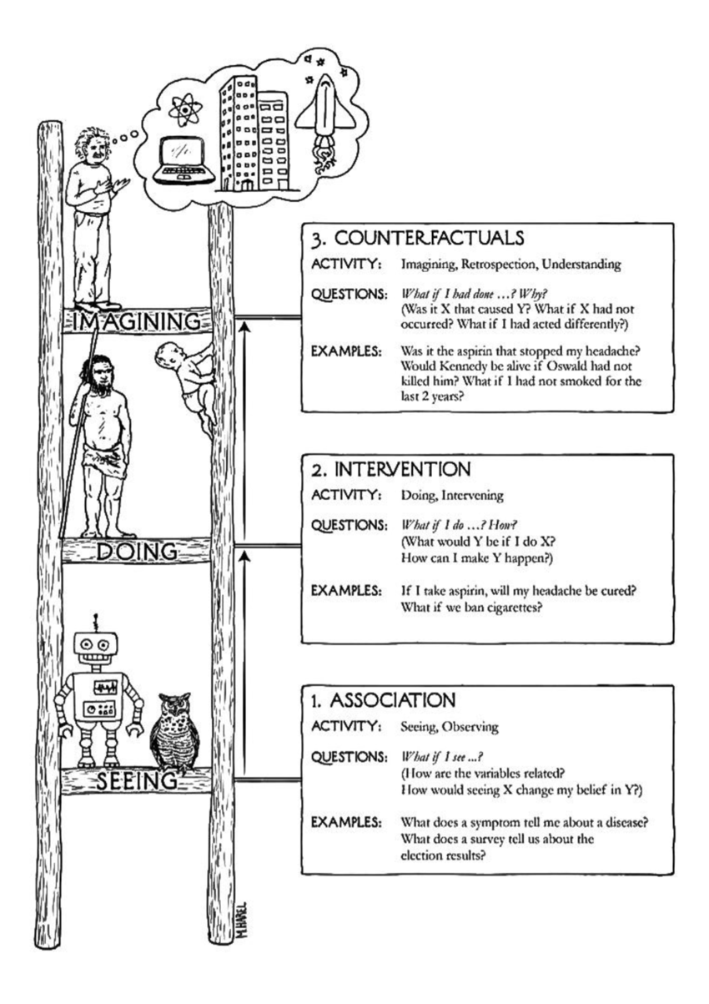
Pearl’s Ladder of Causality
www.cdcs.ed.ac.uk

Slide 6
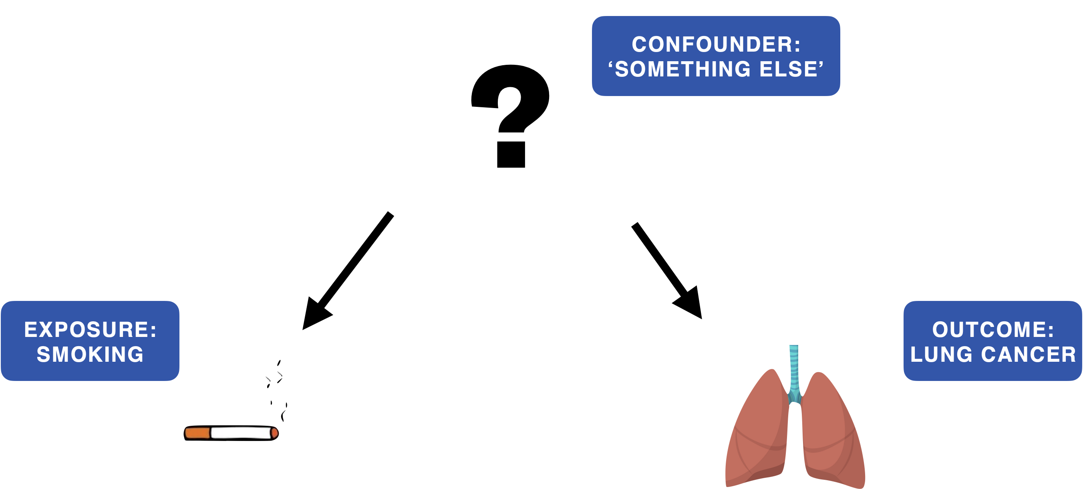
Smoking in the multiverse of madness
www.cdcs.ed.ac.uk

Slide 7
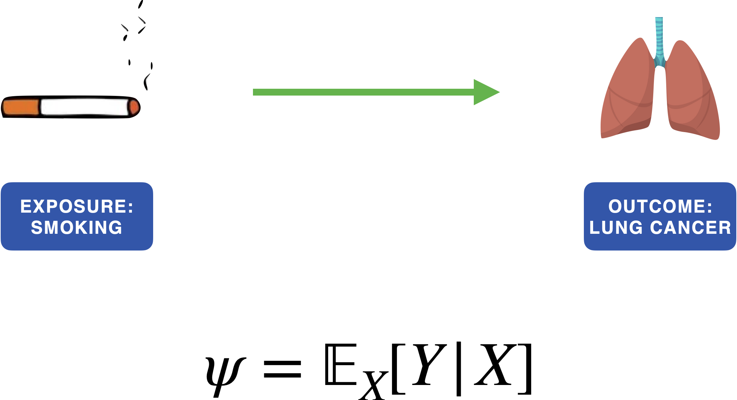
How do we calculate the average causal effect?
www.cdcs.ed.ac.uk

Slide 8

www.cdcs.ed.ac.uk

Slide 9
Well…how do we deal with confounding in general?
Randomisation / Study Design
Matching / Accounting
Instrumental Variables
www.cdcs.ed.ac.uk

Slide 10
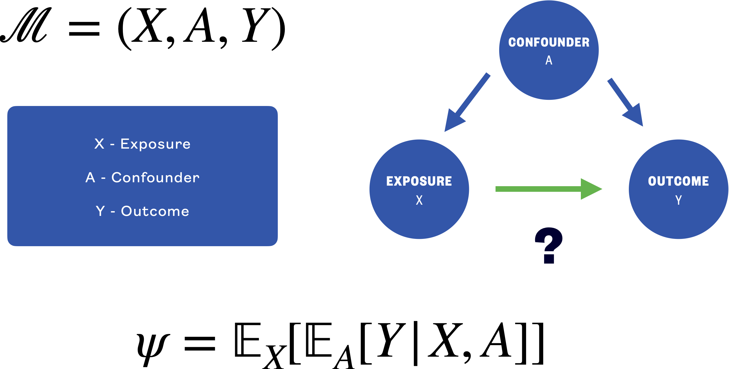
Average causal effect with confounding
www.cdcs.ed.ac.uk

Slide 11
What about mediators? What do I do?
Workplace Policies as a Mediator for Employee Well-Being:
Independent Variable (X): Implementation of workplace policies to reduce stress.
Mediator (M): Employee satisfaction with work-life balance.
Dependent Variable (Y): Employee well-being and job performance.
The implementation of stress-reducing workplace policies (X) may affect employee well-being (Y) through the mediator of employee satisfaction with work-life balance (M). This mediator helps explain how the policies influence employee outcomes.
www.cdcs.ed.ac.uk

Slide 12
Ultimately, leave them alone!
www.cdcs.ed.ac.uk

Slide 13
10 Minute Break

Slide 14
Practical Session 1
www.cdcs.ed.ac.uk

Slide 15
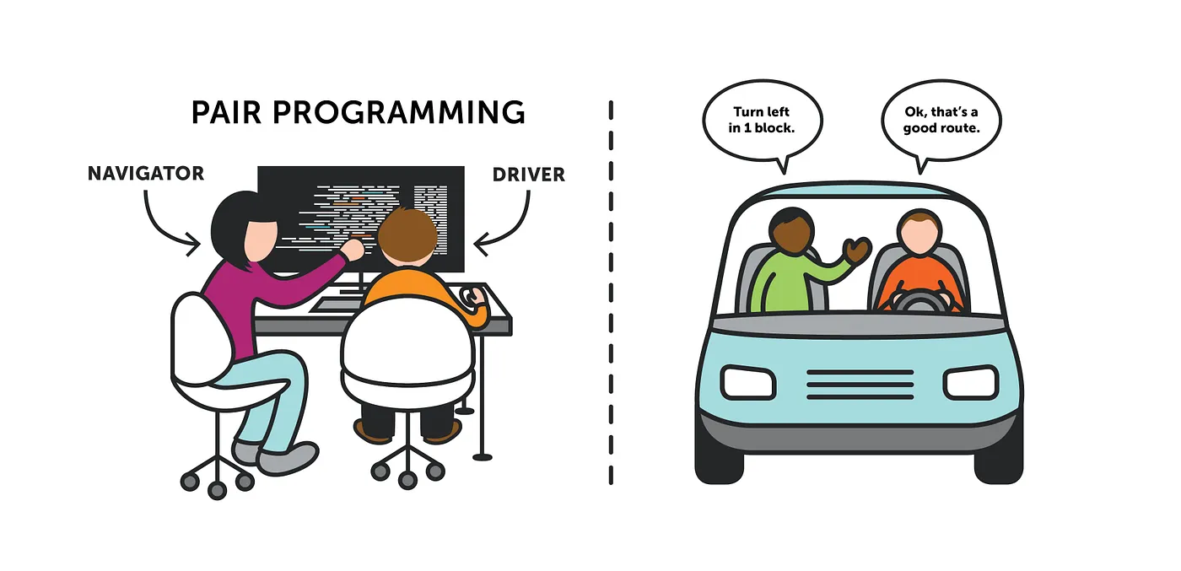
Image from: https://medium.com/@tomspencer_uk/pair-programming-and-problem-solving-4531ef3bf171
www.cdcs.ed.ac.uk

Slide 16
Pair Programming
find a partner
switch driver & navigator roles regularly, e.g., after every task in the notebook
you can work with the same partner throughout the course, or switch between sessions
ask us for help! (yes, even for small things)
www.cdcs.ed.ac.uk

Slide 17
Let’s get programming
For Python:
For R:
Go to https://noteable.edina.ac.uk/login
Login with your EASE credentials
Select RStudio as a personal notebook server and press start.
Go to File > New Project> Version Control > Git
Copy and Paste this repository URL https://github.com/DCS-training/IntroCausalInference as the Repository URL (The Project directory name will filled in automatically but you can change it if you want your folder in Notable to have a different name).
Decide where to locate the folder. By default, it will locate it in your home directory.
Press Create Project Congratulations you have now pulled the content of the repository on your Notable server space.
Go to https://noteable.edina.ac.uk/login
Login with your EASE credentials
Select 'Standard Notebook (Python3)' as a personal notebook server and press start
Click the '+GitRepo'
Copy and Paste this repository URL https://github.com/DCS-training/IntroCausalInference as the Repository URL - you do not need to add in any other fields.
Decide where to locate the folder. By default, it will locate it in your home directory
Press 'Clone' Congratulations you have now pulled the content of the repository on your Notable server space.
www.cdcs.ed.ac.uk

